Slide 1
Warm-Up
Did you know that almost half of the world (over three billion people) lives on less than $2.50 a day.
There are also nearly one billion people who entered the 21st century unable to read a book or sign their names.

Slide 2
Political and Economic Systems

Slide 3
Four Characteristics of a Country
Clearly defined territory
Population
Sovereignty
Government
Notes:
-BEFORE clicking, ask students what they think a country needs to have to be a country. Write their answers on the board, and then compare to the 4 characteristics

Slide 4
Four Characteristics of a Country
Clearly defined territory -Land and water within its national boundaries -All natural resources within
Notes:
-Not only is the state of Georgia within the US, so is the Chattahoochee River, Lake Lanier, etc

Slide 5
Four Characteristics of a Country
Population -Assured the protection of government -Pay taxes -Serve in military
Notes:
-Ask students how does the government protect it’s citizens? Police force, military, laws, safe food, etc
-Talk about the draft, all men have to fill out a draft card when they turn 18

Slide 6
Four Characteristics of a Country
Sovereignty -Establish own policies, determine own course of action -Protect over territory and citizens
Notes:
Sovereignty- the full right and power of a governing body to govern itself without any interference from outside sources or bodies
-INSIDE the US boundaries, the US has the full rights to establish our own policies and laws without listening to someone else

Slide 7
Four Characteristics of a Country
4. Government -The system by which a nation, state, or community is governed -The way of controlling or regulating a nation, organization, or people.
Notes:
Sovereignty- the full right and power of a governing body to govern itself without any interference from outside sources or bodies
-INSIDE the US boundaries, the US has the full rights to establish our own policies and laws without listening to someone else

Slide 8
Government Systems
Unitary- one central government controls the nation
Federal- Power is shared between a central government and smaller divisions
All countries are EITHER unitary OR federal
*Confederation—de-centralized. No power to central government…power to the states. No examples
Notes:
-In a unitary system, it doesn’t necessarily mean that there is no local government. It just means that all government power derives from one central government. The central government can delegate powers to smaller divisions, but then can also take that power away
-FEDERAL- in the US, the Constitution lays out what powers are for the national government, and what powers are reserved to the state governments
-You must be unitary or federal. You cannot be both. You cannot be neither

Slide 9
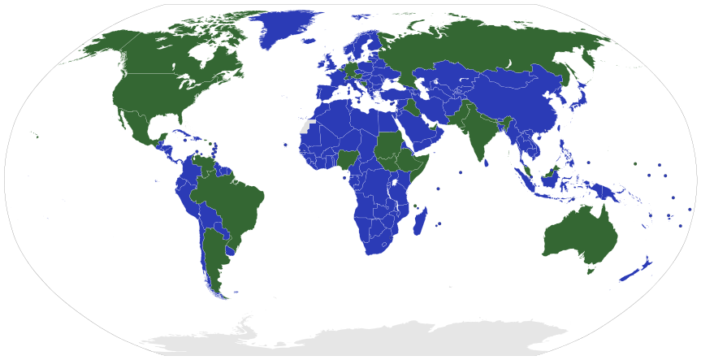
Unitary Federal
Notes:
-Ask students to point out some important countries under both systems

Slide 10
How Citizens Participate
Authoritarian- leader holds all power
Dictatorship- Gains/maintains power through military force or political terror
Totalitarianism- leader controls every aspect of society
Monarchy- inherited position
Oligarchy—rule by a group of people (party, social, etc)
Notes:
-DO NOT CONFUSE AUTHORITARIAN WITH UNITARY. Because a dictatorship exists in a unitary system, sometimes students get confused and think that unitary is bad. But that is not necessarily true. Remember that the UK is a unitary system
-Examples for each type (Cuba: dictatorship, North Korea: Totalitarianism, UK: Monarchy)
-In most modern monarchies, the king or queen does not have all encompassing power. It has evolved to be more of a figurehead position in many countries

Slide 11
How Citizens Participate
Democracy- people choose leaders
True- one man, one vote
Representative- elect people to represent local interests
Notes:
-In the US, do your parents go vote on every single law that’s introduced? Every budget item? Everything on a local, state, national level? NO. It doesn’t make sense. They vote for people who they believe will vote in line with their beliefs on issues, and those elected representatives vote on each individual law, etc.
-Do your parents only vote for one person and that one person chooses everything for them? No- there are state representatives, local representatives, congressmen, senators, the president, etc.
-Can you think of an example of a TRUE democracy that has existed in the history of the world? (Ancient Greece)

Slide 12
Let’s Review Governments!
Notes:
-What are the 4 characteristics of a country?
-What are the two government systems?
-Give me an example of a country with a unitary system? What does a unitary system mean?
-Give me an example of a country with a federal system? What does a federal system mean?
-What are some types of authoritarian governments?
-What are the two different types of democracy?

Slide 13
Economic Systems
Three Basic Economic Questions
1. What to produce?
2. How to produce?
3. For whom to produce?
How a country answers these questions tells us what kind of economic system they have
Notes:
-Make sure students understand the question FOR WHOM

Slide 14
Economic Systems
Command Economy- Production of goods and services is determined by a central government, which usually owns the means of production
Production does not necessarily reflect the consumer demand
Also called a Planned Economy or Communism
Notes:
-Break down the definition. What do these terms mean? What are means of production? What does the second bullet mean?
-Let’s say John comes up with a great idea for a shoe. In most countries, John could buy a shoe factory and make shoes and sell them for a profit. In a command economy, you can’t do that. The government owns the factories. They decide who makes shoes.

Slide 15
Economic Systems
Market Economy- Production of goods and services is determined by the demand from consumers
Also called Capitalism, Demand Economy, Free Market
Notes:
-How does Nike know how many of a certain shoe to make? How do they know how much money to charge for shoes? Does someone tell them? Do they get a secret email that says exactly how many of each shoe to make and how much money to charge for the shoes??
-NO! They will make as many shoes as they believe they can sell, and they will sell them for as much money as they believe they can

Slide 16
Economic Systems
Is any country a TRUE command system or a TRUE market system?
Mixed Economy- A combination of command and market economies provides goods and services so that all people will benefit (Can also be called Socialism)
Notes:
All countries fall somewhere in the middle. It’s very hard to have the government control absolutely EVERY aspect of the economy, and it’s also extremely hard for the government to be completely uninvolved. It’s easy to see why a command economy sounds bad, but imagine a TRUE market system. There are no laws that say people have to wash their hands before they cook your food. There’s no FDA that makes sure our medicine and food is safe. It’s like the wild west with no rules.
-State runs basic industries such as transportation, communication, banking. Sometimes called welfare state because it can provide housing, healthcare, child care

Slide 17
Economic Spectrum
Com
Command
Market
Notes:
-Have students come to the board and write in where they think certain countries fall on the spectrum

Slide 18
Economic Systems
vs.
Government Systems
Notes:
-It’s important to understand how economics and government are directly related, but they are NOT the same thing!
-What ECONOMIC SYSTEM is the US? (Mixed, closer to Market)
-What GOVERNMENT SYSTEM is the US? (Federal)
-What are the three basic economic questions?
-What is a command economy?

Slide 19
Two Stages of Economic Development
Developing Countries
Developed Countries
*Gross Domestic Product (GDP): Total value of goods and services produced in a year. Per Capita GDP—divided by pop.
Notes:
GDP Ranking by International Monetary Fund: US- 17.5trillion dollars
China- 10.4 trillion dollars
Japan 4.6 trillion dollars
If you count the whole European Union together, it would be just above the US at 18.45 million dollars
You will also hear the term GDP per capita. This is the GDP divided by the number of people who live somewhere.
-US is ranked 10th at $54,597 per capita. 1 is Luxembourg with $111,716 per person (total is only
-China drops WAY down to $7589 per capita. Why???

Slide 21
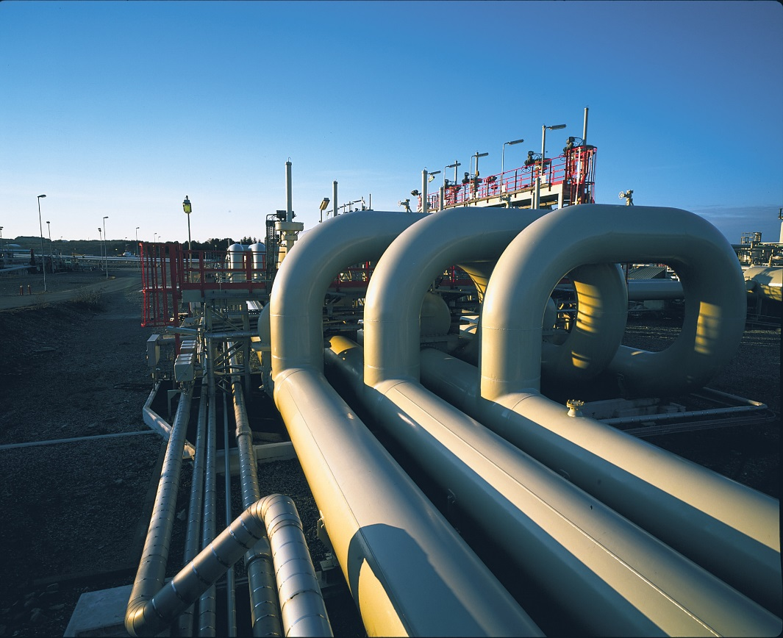
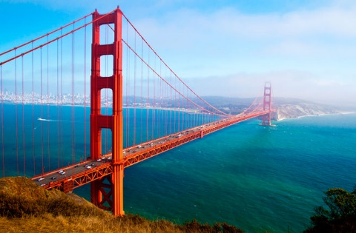
Infrastructure—basic support systems to keep an economy going.
Roads
Bridges
Electrical systems
Pipelines
Water systems
Sewage systems
Educational systems
Railroad lines

Slide 22
Two Stages of Economic Development
Developing Countries
-Do not have modern technology
-Depend on developed nations for manufactured goods
-Have a LOW Per Capita Gross Domestic Product
-Underdeveloped infrastructure
Notes:
-Most developing countries do not have any industry. They extract raw natural resources, sell those resources to developed countries, the developed countries turn the natural resources into usable goods, and then those goods can then be sold back to the developing countries
-Ask students for examples of developing countries

Slide 23
Two Stages of Economic Development
Developed Countries
-Have modern technology and industries
-Have a HIGH Per Capita Gross Domestic Product
-Well developed infrastructure
Notes:
-Ask students for examples of developed countries

Slide 25
Types of Economic
Activities
Primary Activities: Use natural resources directly
Secondary Activities: Use and process natural resources
Tertiary Activities: Not directly related to gathering raw materials or manufacturing

Slide 26
Types of Economic
Activities
Primary Activities: Use natural resources directly
Farming
Fishing
Gathering natural resources

Slide 27
Types of Economic
Activities
Secondary Activities: Use and process natural resources
Industry- Using and processing natural resources
Manufacturing- The process of turning raw materials into finished goods
Notes:
So if John owns a plot of land with rubber trees, he grows the rubber, and then sells it to Firestone. Firestone takes the rubber and turns it into tires. What type of economic activity is John participating in? What type of economic activity is Firestone participating in?

Slide 28
Types of Economic
Activities
Tertiary Activities: Not directly related to gathering raw materials or manufacturing
Transportation, Banking, Sales, Healthcare, Advertising, Government, Education, etc.
Notes:
-The best way to remember if an activity is tertiary is to ask yourself if anything is actually being produced. As a teacher, I don’t have anything to do with raw materials or natural resources. I don’t grow them or catch them. I don’t make them into finished goods. I don’t ever touch them.
-Can anyone else think of an example that isn’t listed that could be tertiary? (Doctor, plumber, stock broker, customer service, etc)

Slide 29
Types of Agriculture
Hunters, Gatherers, and Herders
Live in small family groups in remote areas
Nomadic- Travel to follow the food, herds, etc
Subsistence Farming
Grow only enough food to feed the family/village
May sell or trade any extra food produced
Commercial Farming
Raising crops or animals specifically for sale
Use modern technology

Slide 30
https://www.youtube.com/watch?v=zEN4hcZutO0
Notes:
-First ask students for their initial reactions to the film, then connect it to the material
-What type of economic activity are Alphonse and the other men in the movie participating in?
-What type of economic activity is Hershey Chocolate Company participating it when it makes its chocolate bars?
-Is this a developing country or a developed country? Why?
-What type of farming are they participating in? (This is tricky. It’s actually commercial even though they don’t have modern technology)

